Slide 1
Part of Speech Tagging
W266: Natural Language Processing

Slide 2
Reminders...
Feedback on project proposals complete
If you didn’t hear from us, let us know.
Can continue refining it with our help, but be sure to let us know (private Piazza post) we should take another look
(Do not wait until the course is over to tell us!)
A2 feedback
TAs covered the assignment in office hour (recorded)
Individual feedback will be released this week
A3 feedback
TAs will cover the assignment this coming office hour
Feel free to drop by OH for additional feedback on assignments, projects, etc

Slide 3
Project midpoint
Completely optional and ungraded, but...
An opportunity for us to take a first look at your project report
Aim to do it when you’ve got some block of work completed (baseline models, for example)
We’ll either provide feedback over email or in an OH.
There will be some latency between giving us your draft and us providing comments, so the earlier the better!

Slide 4
This week...
Part of Speech
High level goals
Dynamic programming review
Hidden Markov Models
Two perspectives on decoding:
Forward/Backward
Viterbi
Expectation-Maximization (EM) algorithm

Slide 5
Part of Speech Tagging

Slide 6
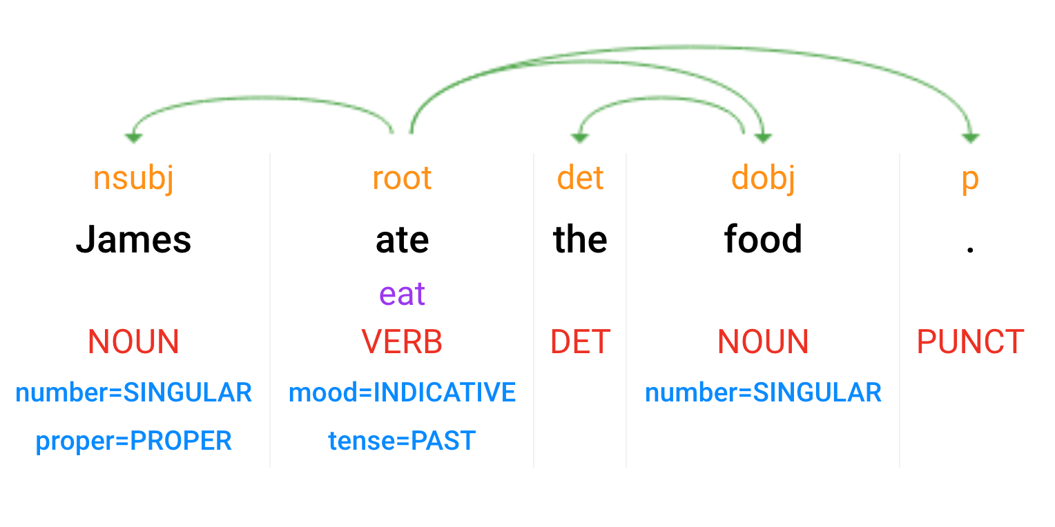
Syntactic Analysis
Parsey McParseface: https://cloud.google.com/natural-language/
Dependency Parse
(+ dependency types)
(Week 9)
Lemmas
Part-of-Speech Tags
(Week 8)
Morphology
Notes:
Scroll down for the test console

Slide 7
Universal Dependencies Tagset
http://universaldependencies.org/u/pos/index.html
ADJ: adjective
ADP: adposition
ADV: adverb
AUX: auxiliary
CCONJ: coordinating conjunction
DET: determiner
INTJ: interjection
NOUN: noun
NUM: numeral
PART: particle
PRON: pronoun
PROPN: proper noun
PUNCT: punctuation
SCONJ: subordinating conjunction
SYM: symbol
VERB: verb
X: other
Notes:
Penn Treebank has another commonly used tagset, with more categories: http://www.surdeanu.info/mihai/teaching/ista555-fall13/readings/PennTreebankConstituents.html#Word

Slide 8
Part of Speech
Goal:
Given a sentence, what role does each word play?
Grade school: NOUN, PRONOUN, ADJ, VERB, ...
Why is this useful?

Slide 9
Part of Speech
Goal:
Given a sentence, what role does each word play?
Grade school: NOUN, PRONOUN, ADJ, VERB, ...
Why is this useful?
Resolve ambiguity:
“Time flies like an arrow, fruit flies like a banana.”
“bank.v into a turn” / “go to the bank.n”
Abstract from words -> syntactic patterns
Useful as input to other systems

Slide 10
Part of Speech
Goal:
Given a sentence, what role does each word play?
Grade school: NOUN, PRONOUN, ADJ, VERB, ...
Tooling:
Dynamic Programming
Hidden Markov Models

Slide 11
Dynamic Programming

Slide 12
Dynamic programming review
Dynamic programming: problem composed of optimal subproblems
Dynamic programming: cache intermediate results.
Notes:
“Programming” here is an old sense of the word, as in “table filling” (think “television programming”). Dynamic refers to the table changing as we go.

Slide 13
Ways up the stairs
If you can only take steps one at a time or two at a time:
How many ways are there up a staircase of “n” stairs?
Notes:
As you’re going up, make a decision at each step.
Or, in reverse: what if I just took one step? What if I just took two steps? Then, recurse.

Slide 14
Ways up the stairs
If you can only take steps one at a time or two at a time:
How many ways are there up a staircase of “n” stairs?
ways(n) = ways(n - 1) + ways(n - 2)

Slide 15
Ways up the stairs
If you can only take steps one at a time or two at a time:
How many ways are there up a staircase of “n” stairs?
ways(n) = ways(n - 1) + ways(n - 2)
[You may recognize this as the Fibonacci series!]
fib = [0, 1]
for _ in range(n):
fib.append(fib[-1] + fib[-2])

Slide 16
Exponential Time
fib(n)
fib(n-1)
fib(n-2)
fib(n-2)
fib(n-3)
fib(n-3)
fib(n-4)
fib(n-3)
fib(n-4)
fib(n-5)
fib(n-6)
fib(n-4)
fib(n-5)
fib(n-4)
fib(n-5)

Slide 17
Exponential Time
fib(n)
fib(n-1)
fib(n-2)
fib(n-2)
fib(n-3)
fib(n-3)
fib(n-4)
fib(n-3)
fib(n-4)
fib(n-5)
fib(n-6)
fib(n-4)
fib(n-5)
fib(n-4)
fib(n-5)

Slide 18
Linear Time
fib(n)
fib(n-1)
Markov order 2
fib(n-2)
fib(n-3)
fib(n-4)
fib(n-5)
fib(n-6)

Slide 19
Ways up the stairs
If you can only take steps one at a time or two at a time:
How many ways are there up a staircase of “n” stairs?
ways(n) = ways(n - 1) + ways(n - 2)
[You may recognize this as the Fibonacci series!]
fib = [0, 1]
for _ in range(n):
fib.append(fib[-1] + fib[-2])
# note the Markov assumption!
# fib(n) = g(fib(n-1), fib(n-2))

Slide 20
Edit Distance
Fill table from top left to bottom right:
 |  |  |  | ins | ins |  | sub
 |  | <start> | S | a | t | u | r | d | a | y
 | <start> | 0 | 1 | 2 | 3 | 4 | 5 | 6 | 7 | 8
 | S | 1 | 0 | 1 | 2 | 3 | 4 | 5 | 6 | 7
 | u | 2 | 1 | 1 | 2 | 2 | 3 | 4 | 5 | 6
sub | n | 3 | 2 | 2 | 2 | 3 | 3 | 4 | 5 | 6
 | d | 4 | 3 | 3 | 3 | 3 | 4 | 3 | 4 | 5
 | a | 5 | 4 | 3 | 4 | 4 | 4 | 4 | 3 | 4
 | y | 6 | 5 | 4 | 4 | 5 | 5 | 5 | 4 | 3
Notes:
Table from https://en.wikipedia.org/wiki/Wagner%E2%80%93Fischer_algorithm
Edit distance is a type of first-order Markov model, and closely related to an HMM where the hidden states are {ins, del, sub}.

Slide 21
Hidden Markov Model (HMM) Async Review
(At light speed)

Slide 22
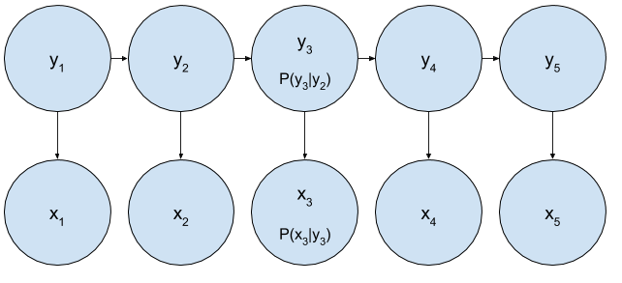

Slide 23
What’s in a name?
Part of a bigger class of Probabilistic Graphical Models
Hidden?
Markov?

Slide 24
Markov order 1
Hidden
states

Slide 25
HMM Terminology
Parts of the model:
x_{i} : observed nodes (i.e. words)
y_{i} : hidden nodes (i.e. POS tags) - usually, try to predict these
Transitions: p(y_{i} | y_{i-1}) (horizontal arrows)
Emissions: p(x_{i} | y_{i}) (vertical arrows)
Things to Do:
Training: learn p(y_{i} | y_{i-1}) and p(x_{i} | y_{i}), p(y₀)
Inference: given x_{i} , infer y_{i} or p(y_{i} | x_{i})
Notes:
Two types of inference: MAP (maximum a posteriori/argmax) and marginal (probabilities). Use Viterbi and Forward-Backward, respectively.

Slide 26
Training time: what can we learn?
State A
State B
State A
State B
State A
State B
State A
State B
Notes:
P(red | A) = 1.0
P(red | B) = 0.25
P(A -> A) = 0.0
P(A -> B) = 1.0 = P(A | B)
P(B -> A) = 1.0
P(B -> B) = 0.0

Slide 27
Inference time: What are the states?
{A,B}
{A,B}
{A,B}
{A,B}
{A,B}
{A,B}
{A,B}

Slide 28
Inference time: What are the states?
State B
State A
State B
State A
State B
State A
State B

Slide 29
HMMs: POS Training
Just count and normalize! (over training data)
Transitions: p(y_{i} | y_{i-1})
c(N,V) = 1
c(V, DT) = 1
c(DT, N) = 1
Emissions: p(x_{i} | y_{i})
c(N, James) = 1
c(V, ate) = 1
c(DT, the) = 1
c(N, food) = 1
N
V
DT
N
James
ate
the
food

Slide 30
HMMs: POS Inference
James
ate
the
food

Slide 31
HMMs: POS Inference
Brute force:
Enumerate all possible state assignments
Score each assignment
Do one of:
Pick the “best”
Compute statistics
James
ate
the
food

Slide 32
HMMs: POS Inference - MAP sequence
Scored assignments:
N, V, DT, N: 0.4
N, N, N, N: 0.3
V, N, V, V: 0.3
… : 0.0
Which do you pick?
Viterbi
James
ate
the
food

Slide 33
HMMs: POS Inference - MAP sequence
Scored assignments:
N, V, DT, N: 0.4
N, N, N, N: 0.3
V, N, V, V: 0.3
… : 0.0
Which do you pick?
Viterbi
James
ate
the
food

Slide 34
HMMs: POS Inference - marginal probabilites
Scored assignments:
N, V, DT, N: 0.4
N, N, N, N: 0.3
V, N, V, V: 0.3
… : 0.0
Which do you pick?
Forward/backward
James
ate
the
food
Notes:
This gives you the correct probability distribution for a single position taking the context into account - but disregarding what the actual tags of the context might be.
We can repeat this at each position to get a sequence, which is called the Minimum Bayes Risk (MBR) solution. This minimizes the expected loss if we care about each token individually - but it might not give a sequence that is self consistent.

Slide 35
HMMs: Forward-Backward
Scored assignments:
N, V, DT, N: 0.4
N, N, N, N: 0.3
V, N, V, V: 0.3
Steps:
Find the sequences to get N (or V, or whatever) in position 2
Find the sequences that carry on from N in position 2
Add them all up.
James
ate
the
food

Slide 36
HMMs: Viterbi
Scored assignments:
N, V, DT, N: 0.4
N, N, N, N: 0.3
V, N, V, V: 0.3
Steps:
Find the best sequence to get V in position 2
Find the best suffix with V in position 2
Take the best overall sequence
James
ate
the
food

Slide 37
HMMs: POS Inference
N
N
N
N
V
V
V
V
DT
DT
DT
DT
James
ate
the
food

Slide 38
HMMs: POS Inference
Transitions: p(y_{i} | y_{i-1})
N
N
N
N
V
V
V
V
DT
DT
DT
DT
James
ate
the
food

Slide 39
HMMs: POS Inference
Emissions: p(x_{i} | y_{i})
N
N
N
N
V
V
V
V
DT
DT
DT
DT
James
ate
the
food

Slide 40
HMM math… the details, slowly

Slide 41

Some math...
Does not depend on POS

Slide 42


Forward / Backward
All the ways to start, resulting in a N at position 2
All the ways to carry on from a N in position 2

Slide 43

Forward / Backward: Apply Dynamic Programming
Don’t recompute the summation from scratch...

Slide 44
HMMs: Forward Algorithm
N
α(0,N) = p(James | N) x p(N) [for first element]
V
α(0,V) = p(James | V) x p(V) [for first element]
DT
α(0,DT) = p(James | DT) x p(DT) [for first element]
James
ate
the
food

Slide 45
HMMs: Forward Algorithm
N
N
α(1,N) = p(ate | N) x [ p(N | N) α(0,N) + p(N | V) α(0,V) + p(N | DT) α(0,DT) ]
V
V
α(1,V)
DT
α(1,DT)
DT
James
ate
the
food

Slide 46
HMMs: Forward Algorithm
N
N
α(1,N) = p(ate | N) x [ p(N | N) α(0,N) + p(N | V) α(0,V) + p(N | DT) α(0,DT) ]
V
V
α(1,V) = p(ate | V) x [ p(V | N) α(0,N) + p(V | V) α(0,V) + p(V | DT) α(0,DT) ]
DT
DT
α(1,DT)
James
ate
the
food

Slide 47
HMMs: Forward Algorithm
N
N
N
α(2,N) = p(the | N) x [ p(N | N) α(1,N) + p(N | V) α(1,V) + p(N | DT) α(1,DT) ]
V
V
V
α(2,V)
DT
DT
DT
α(2,DT)
James
ate
the
food

Slide 48
HMMs: Forward Algorithm
N
N
N
N
α(3,N) = p(food | N) x [ p(N | N) α(2,N) + p(N | V) α(2,V) + p(N | DT) α(2,DT) ]
V
V
V
V
α(3,V)
DT
DT
DT
DT
α(3,DT)
James
ate
the
food

Slide 49
HMMs: Forward Algorithm
N
N
N
N
α(3,N) ∝ p(y₃ = N) [for last element]
V
V
V
V
α(3,V) ∝ p(y₃ = V) [for last element]
DT
DT
DT
DT
α(3,DT) ∝ p(y₃ = DT) [for last element]
α(n-1,N) + α(n-1,V) + α(n-1,DT) = p(x)
James
ate
the
food

Slide 50
HMMs: Backward Algorithm
Just like Forward Algorithm, but go backwards.
Be careful not to double-count an edge!
Initialize: [for last element]
β(3,N) = 1
β(3,V) = 1
β(3,DT) = 1
β(2,N) = [ p(food | N) p(N | N) β(3,N)
+ p(food | V) p(V | N) β(3,V)
+ p(food | DT) p(DT | N) β(3,DT) ]
N
N
β(2,V)
V
V
β(2,DT)
DT
DT
James
ate
the
food

Slide 51
HMMs: Backward Algorithm
Just like Forward Algorithm, but go backwards.
Be careful not to double-count an edge!
β(2,N) = [ p(food | N) p(N | N) β(3,N)
+ p(food | V) p(V | N) β(3,V)
+ p(food | DT) p(DT | N) β(3,DT) ]
N
N
β(2,V)
V
V
β(2,DT)
DT
DT
James
ate
the
food

Slide 52
HMMs: Backward Algorithm
β(1,N) = [ p(the | N) p(N | N) β(2,N)
+ p(the | V) p(V | N) β(2,V)
+ p(the | DT) p(DT | N) β(2,DT) ]
N
N
N
β(1,V)
V
V
V
β(1,DT)
DT
DT
DT
James
ate
the
food

Slide 53
HMMs: Backward Algorithm
β(0,N) = [ p(ate | N) p(N | N) β(1,N)
+ p(ate | V) p(V | N) β(1,V)
+ p(ate | DT) p(DT | N) β(1,DT) ]
N
N
N
N
β(0,V)
V
V
V
V
β(0,DT)
DT
DT
DT
DT
James
ate
the
food

Slide 54
HMMs: Backward Algorithm
[for first element]
p(James | N) β(0,N) ∝ p(y₀ = N)
N
N
N
N
[for first element]
p(James | N) β(0,V) ∝ p(y₀ = V)
V
V
V
V
[for first element]
p(James | DT) β(0,DT) ∝ p(y₀ = DT)
DT
DT
DT
DT
James
ate
the
food

Slide 55
HMMs: Forward-Backward Algorithm
N
N
N
N
α(1,N) β(1,N) ∝ p(y₁ = N)
V
V
V
V
α(1,V) β(1,V) ∝ p(y₁ = V)
DT
DT
DT
DT
α(1,DT) β(1,DR) ∝ p(y₁ = DT)
James
ate
the
food

Slide 56
HMMs: Forward-Backward Algorithm
N
N
N
N
α(1,N) β(1,N) ∝ p(y₁ = N)
V
V
V
V
α(1,V) β(1,V) ∝ p(y₁ = V)
DT
DT
DT
DT
α(1,DT) β(1,DR) ∝ p(y₁ = DT)
James
ate
the
food
Notes:
Sid: Shouldn’t all 2’s be replaced with 1’s in the equations given that we start counting with 0?

Slide 57
HMMs: Forward-Backward Algorithm
N
N
N
N
α(1,N) β(1,N) ∝ p(y₁ = N)
V
V
V
V
α(1,V) β(1,V) ∝ p(y₁ = V)
DT
DT
DT
DT
α(1,DT) β(1,DR) ∝ p(y₁ = DT)
James
ate
the
food

Slide 58
HMMs: Viterbi Decoding
N
N
δ(1,N) = p(ate | N) x max{ p(N | N) δ(0,N),
p(N | V) δ(0,V),
p(N | DT) δ(0,DT) }
V
V
δ(1,V)
(also store backpointers)
DT
DT
δ(1,DT)
James
ate
the
food

Slide 59
The EM Algorithm
(Optional discussion)

Slide 60
What if we don’t have labels?
Motivation: unsupervised POS tagging
Given raw text, find underlying patterns (according to some model)
Not great performance for POS tagging
But, approach useful for many other tasks!
Clustering / topic modeling
Machine translation (alignment models)
Speech recognition (HMM/GMM models)
Computational biology
Cryptography
And much, much more!

Slide 61
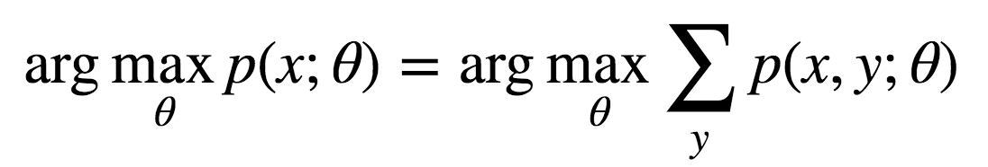
EM Algorithm
Setting: unsupervised learning (or sequence modeling)
Method for learning latent variables
In unsupervised tagging, y unobserved.
Goal: maximize likelihood of data x according to model
Only makes sense for a generative model (need to model p(x,y))
Notes:
Note: can also use for supervised problems where intermediate variables are unobserved. We’ll do this for MT in a few weeks.

Slide 62
EM Algorithm for HMMs
EM is an alternating optimization of p(y; θ):
Expectation: assign “soft values” to latent variables y
Maximization: optimize model θ based on values of y
E-step looks like inference; run forward-backward.
M-step looks like training, using labels from E-step.
Alternate E-step, M-step until convergence.

Slide 63
EM Algorithm for HMM
E-step: inference, M-step: training. For HMM, training is just counts!

Slide 64
HMMs: E-Step for Emissions
p(x) = 𝝨_{y} α(i,y) β(i,y) (for any i)
N
N
N
N
α(2,N) β(2,N) ∝ p(y₂ = N)
V
V
V
V
α(2,V) β(2,V) ∝ p(y₂ = V)
DT
DT
DT
DT
α(2,DT) β(2,DT) ∝ p(y₂ = DT)
E-step: (emissions)
c(ate, N) += p(y₂ = N)
c(ate, V) += p(y₂ = V)
c(ate, DT) += p(y₂ = DT)
James
ate
the
food
Notes:
Recall that alpha(2,N) includes the emission p(ate | N), and so on. So, can think of E-step as re-computing a better estimate for that edge, based on the rest of the sequence but including the current weight.

Slide 65
HMMs: E-Step for Transitions
p(x) = 𝝨_{y} α(i,y) β(i,y) (for any i)
N
N
N
N
c(y₁ = N, y₂ = N) ∝
α(2,N) p(N | N) p(the | N) β(3,N)
c(y₁ = N, y₂ = V) ∝
α(2,N) p(V | N) p(the | V) β(3,V)
c(y₁ = N, y₂ = DT) ∝
α(2,N) p(DT | N) p(the | DT) β(3,DT)
(and so on for all k² edges)
V
V
V
V
DT
DT
DT
DT
E-step: (transitions)
c(N, N) += c(y₁ = N, y₂ = N)
c(N, V) += c(y₁ = N, y₂ = V)
c(N, DT) += c(y₁ = N, y₂ = DT)
James
ate
the
food

Slide 66
HMMs: E-Step for Transitions
p(x) = 𝝨_{y} α(i,y) β(i,y) (for any i)
N
N
N
N
c(y₁ = N, y₂ = N) ∝
α(2,N) p(N | N) p(the | N) β(3,N)
c(y₁ = N, y₂ = V) ∝
α(2,N) p(V | N) p(the | V) β(3,V)
c(y₁ = N, y₂ = DT) ∝
α(2,N) p(DT | N) p(the | DT) β(3,DT)
(and so on for all k² edges)
V
V
V
V
DT
DT
DT
DT
E-step: (transitions)
c(N, N) += c(y₁ = N, y₂ = N)
c(N, V) += c(y₁ = N, y₂ = V)
c(N, DT) += c(y₁ = N, y₂ = DT)
James
ate
the
food

Slide 67
HMMs: E-Step for Transitions
p(x) = 𝝨_{y} α(i,y) β(i,y) (for any i)
N
N
N
N
...
c(y₁ = DT, y₂ = N) ∝
α(2,DT) p(N | DT) p(the | N) β(3,N)
...
(and so on for all k² edges)
V
V
V
V
DT
DT
DT
DT
E-step: (transitions)
c(DT, N) += c(y₁ = DT, y₂ = N)
c(DT, V) += c(y₁ = DT, y₂ = V)
c(DT, DT) += c(y₁ = DT, y₂ = DT)
James
ate
the
food

Slide 68
HMMs: M-Step
M-step looks like training, using (soft) labels from E-step.
From partial counts, just train HMM!
Transitions: p(y_{i} | y_{i-1})
Estimate from counts c(y, y’)
Emissions: p(x_{i} | y_{i})
Estimate from counts c(x, y)

Slide 69
Latent Variable Models
Optimizations not guaranteed to converge! But, often work well in practice.
Problems are generally non-convex, intractable.
Many methods to solve approximately or locally:
EM algorithm
Sampling methods
Variational methods
Backpropagation (for differentiable models, e.g. NN)

Slide 70
Next up: Parsing

Slide 71
Syntactic Analysis
Parsey McParseface: https://cloud.google.com/natural-language/
Dependency Parse
(+ dependency types)
(Week 9)
Lemmas
Part-of-Speech Tags
(Week 8)
Morphology
Notes:
Scroll down for the test console

Slide 72
Syntactic Analysis
Dependency Parsing (Week 9)

Slide 73
Syntactic Analysis
Constituency / Phrase-Structure Parsing (Week 10)
S
NP
VP
NP
NNP
VBD
DT
NN
James
ate
the
food

Slide 74
HMMs: POS Training
Just count and normalize! (over training data)
Transitions: p(y_{i} | y_{i-1})
p(V | N) = .8 p(N) = 0.79
p(DT | V) = 1
p(N | DT) = 1
Emissions: p(x_{i} | y_{i})
p(James|N) = 0.5
p(ate | V) = .7
p(the | DT) = .8
p(food | N) = 0.5
p(N)[0.79] * P(James|N)[0.5] *P(V|N)[0.8]*P(ate|V)[0.7]*P(DT|V)[1.0]*P(the|DT)[.8]P(N|DT)[....
N
V
DT
N
James
ate
the
food

Slide 75


Forward Math

